Slide 1


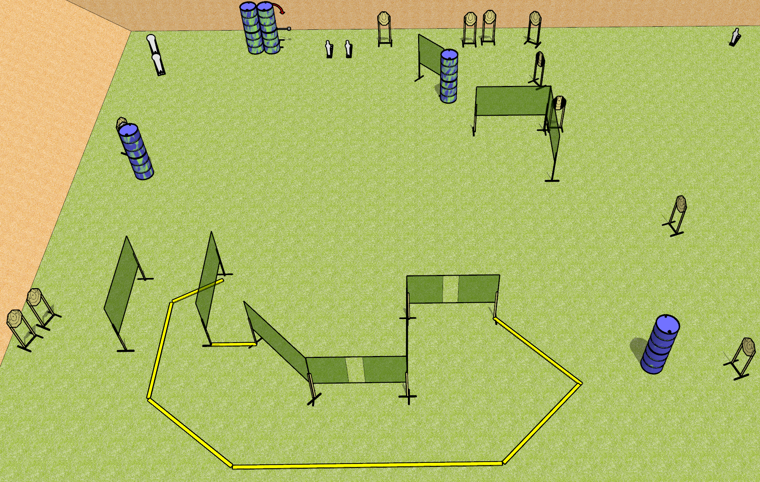
 | Dothan Gun Club – USPSA Match Not Stage #5 Course Designer : Drew Coleman
Round Count 29 rounds 12 IPSC 2 colt, 3 mini
Equipment List 15 wall feet Swinger + activator 2 tux + 10 targets (9 + 1 NS) Use 10’ fault lines for right side area

Slide 2
Not Stage #5
Written Stage Briefing
Scoring: Comstock
Targets: 12 IPSC, 5 poppers
Rounds: 29
Handgun start position: anywhere inside the shooting area, wrists below belt. Handgun is loaded and holstered.
PCC start position: anywhere inside the shooting area, stock on belt. Carbine is loaded.
Stage Procedure: on the audible start signal, engage targets as they become available from within the shooting area. The swinger is activated by P3 and remains visible at rest.

